Slide 1
Crop Recommendation BUILD A PREDICTIVE MODEL TO RECOMMEND THE MOST SUITABLE CROPS TO GROW IN A PARTICULAR FARM BASED ON VARIOUS PARAMETERS USING CROP RECOMMENDATION DATASET.
TEAM-4 CSE-A
Gauri Santhosh (20023)
Gokul Siddarth S (20024)
Gollu Twikil (20025)
Guhan N K (20026)
Gunde Eliyajer (20027)
Haree Krishna P P (20028)
Hrushikesava Reddy V (20029)

Slide 2
Abstract
Agriculture in India plays a major role in economy and employment.
The Common difficulty present among the Indian Farmers are they don’t opt for the proper crop
based on their soil Neccesities Precision agriculture is in trend nowadays.
It helps the farmers to get informed decision about the farming strategy.
Here, we present a crop recommendation dataset which would allow the users
to build a predictive model to recommend the most suitable crops to grow in a particular farm
based on various parameters.

Slide 3
Introduction
Agriculture crop recommendation is a new generation bubble that is engaging the masses.
In most of the cases, the farmers are not well aware of the kind of crops they should be growing in their farms.
This leads to a lot of confusion and affects the productivity.
We have gathered a dataset built by augmenting datasets of rainfall, climate and fertilizer data available for India.
This will give us a better idea of the trends of crops considering different environmental and geographical factors.
We can use this dataset to create a machine learning model for predicting the best suitable crop to grow at a particular place.
IDEA-- Provide the farmers with an ideal recommendation for growing crops taking into consideration the
factors *composition of soil,
*the environmental factors like temperature, humidity, rainfall and
* the geographical influence.

Slide 4
Problem Statement
Farmers do not choose the right crop based on the market scenario
Difficulty to understand climatic conditions due to strong climatic changes
Farmers unable to Understand which crop to select by which the prediction will improve.

Slide 5
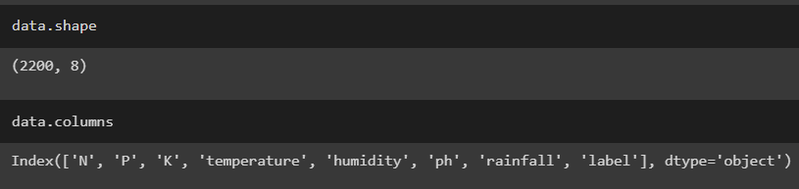
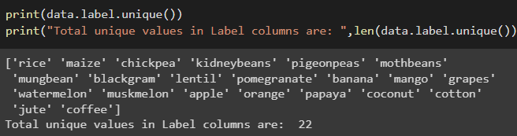
Dataset Description
This Crop Recommendation dataset was build by augmenting datasets of rainfall, climate and fertilizer data available for India.
N - ratio of Nitrogen content in soil
P - ratio of Phosphorous content in soil
K - ratio of Potassium content in soil
temperature - temperature in degree Celsius
humidity - relative humidity in %
ph - ph value of the soil
rainfall - rainfall in mm

Slide 6
Module Description
Data Preprocessing
Scikit-Learn Scikit-learn
Outlier Detection and Removing Outliers
Data Visualization.
Correlation
train_test_split Library
Confusion matrix
Accuracy

Slide 7
Algorithms used
Light GBM-
Supervised ensemble Machine Learning algorithm.
Gradient boosting framework.
Fast processing algorithm.
Decision Tree Algorithm-
Supervised Machine Learning Algorithm
Data is continuously divided at each row based on certain rules until the final outcome is generated.
Logistic regression-
Classification Algorithm.
To predict a binary outcome based on a set of Independent variables.

Slide 8
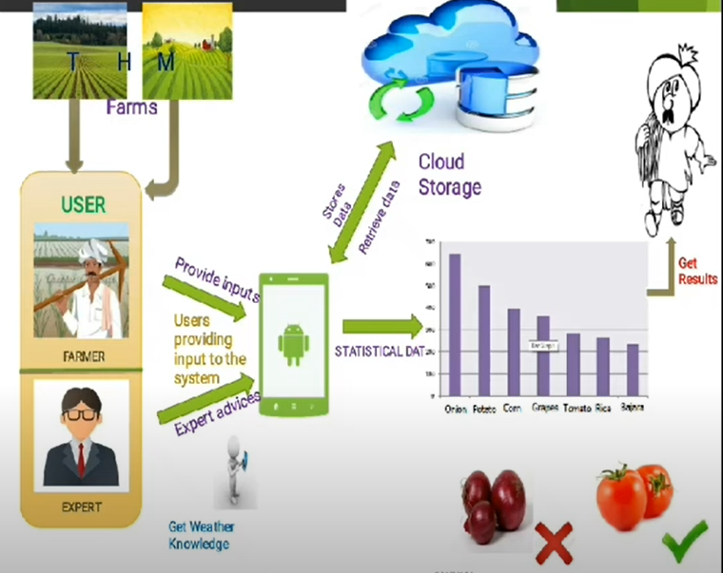
System Architecture

Slide 9
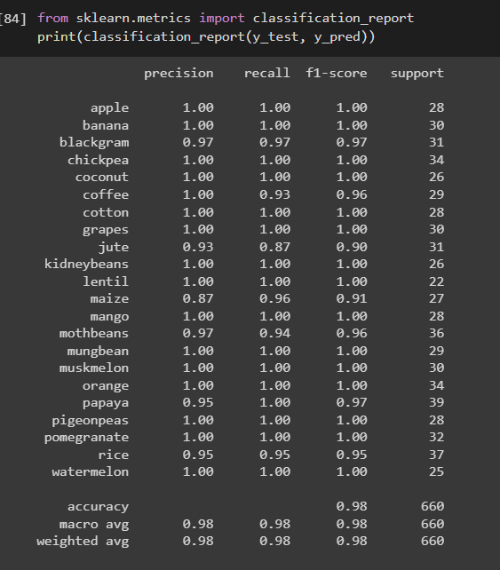
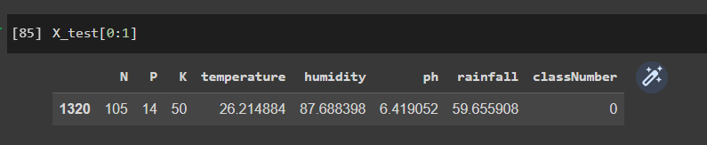
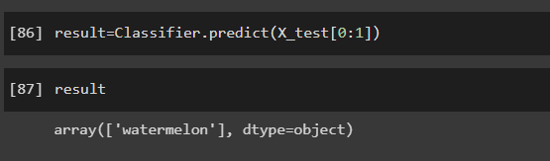
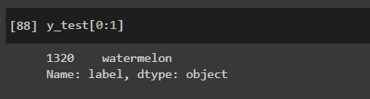
Results and Discussions

Slide 10
Conclusion
The system will provide the statistical analysis of crops.System is a stepping stone towards more automated resolution of farmer assistant system which will solve many problems of farmers.
The prediction can help us make strategic decisions in crop production .
The model using Decision Tree Classifier will giving more acuracy and better F1 score.
We Observe that the Actual Value and Predicted Value are Equal ,it says that our model is working perfectly with 98% Accuracy.

Slide 11
FUTURE SCOPE
As the smart Farming Methodologies Increase There Would A Vast Requirement for newer technologies to be implemented.
Once the predition is done we can improve on the automation process where the farmers can remotely control the field using a mobile app.
This also predicts or measures the weather conditions ,soil contents .
This app can also be used by the government to suggest farmers about the crop that they can grow to have maximum outcome according to their soil & weather conditions.

Slide 12
REFERENCE
IRJET- Smart Farming Crop Yield Prediction using Machine Learning.
IEEE-Analysis of crop yield prediction using data mining techniques.
https://www.kaggle.com/atharvaingle/crop-recommendation-dataset.

